Slide 1
Life Expectancy Analysis
May 11th, 2025
Elijah Taber | Caleb Trimble | Michael Speer
DSC450 - Applied Data Science
Professor Fadi Alsaleem

Slide 2
Introduction
Introduction
Life Expectancy Analysis
Global Context: Population shifts impact quality of life, labor markets, and economic stability.
Critical Questions:
How have U.S. life expectancy and death rates evolved?
What role do pandemics, healthcare, and equity play?

Slide 3
The Problem
Defining the Problem
Life Expectancy Analysis
Declining Population Levels
Populations across the globe have seen gradual declines, with less people being born than dying.
Life Expectancy Disparity
Significant disparity for life expectancy depending on several biological factors.

Slide 4


Data Sources
Data Sources
Life Expectancy Analysis
United States Census Bureau Apportionment (1910-2020)
Life Expectancy and Age-adjusted Death Rate (1900-2018)

Slide 5
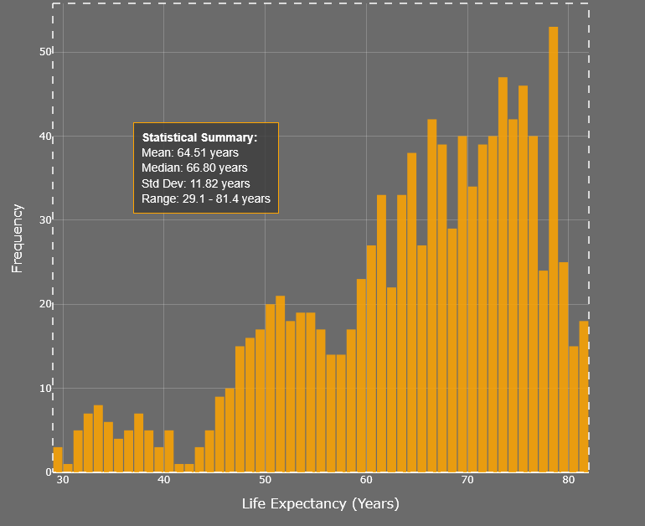
Statistical Summary
Life Expectancy Summary
Life Expectancy Analysis
General range of 55 to 75 years
Tail dipping into the 30s and 40s
Rightward shifts reflect the impact of vaccines, antibiotics, and expanded healthcare access
Sharp declines in 1918 and 2020 highlight influenza and COVID-19 pandemics

Slide 6
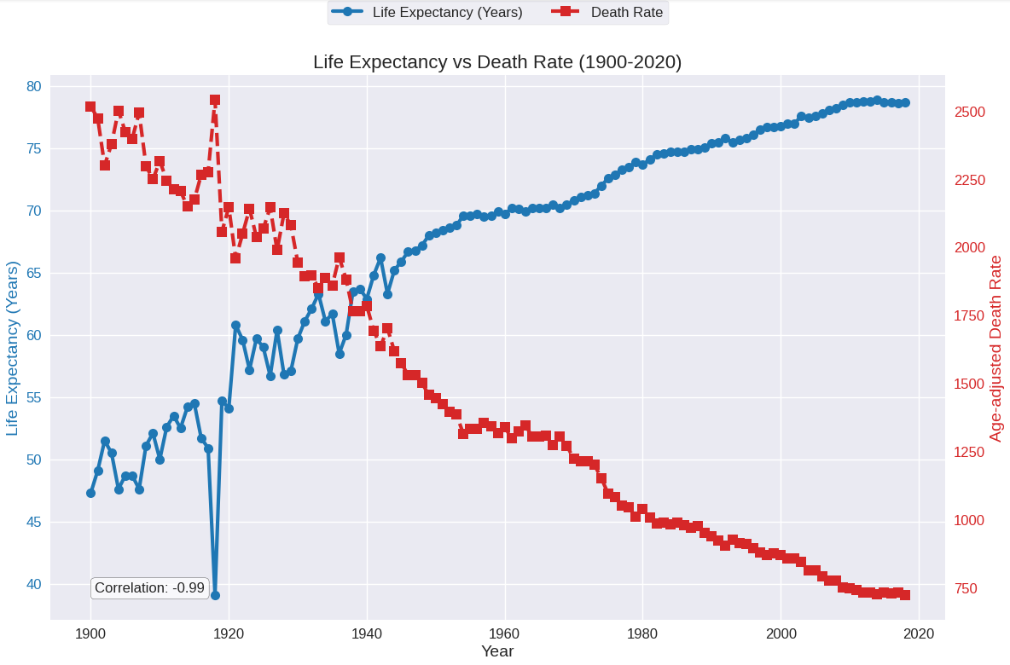
Exploratory Data Analysis
Methodology
Life Expectancy Analysis
Examined the bivariate relationship between mortality and longevity
Strong inverse correlation (Pearson’s r ≈ –0.99), indicating reductions in mortality nearly linearly increase lifespan
Complete-case correlations were used to ensure robustness and avoid spurious imputation effects
Important Insight: Pandemics caused temporary dips but did not reverse long-term gains.

Slide 7
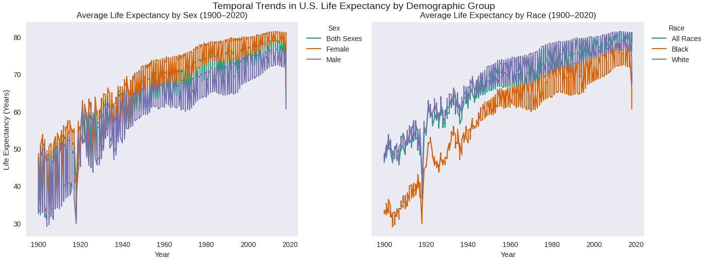

Life Expectancy By Race and Sex
Methodology (Cont.)
Life Expectancy Analysis
Temporal trends stratified by sex and race reveal trends in life expectancy throughout the decades
Observations
Females consistently outlive males
White populations maintain higher average life expectancy than black populations
Substantial gains for all groups since 1900.

Slide 8
Predictive Models
Methodology (Cont. II)
Life Expectancy Analysis
Linear Regression model (linear)
Moderate predictive accuracy
Mean Absolute Error (MAE) = 2.78 years
R² = .897
Decision Tree Regression (non-linear)
Error reduced significantly
MAE = .69
R² = .987
Random Forest Regression (ensemble)
Best performing model
MAE = .54
R² = .991

Slide 9
Life Expectancy Predictions
Predictions
Life Expectancy Analysis
Life Expectancy is predicted to increase to 90 by 2037
Gaps narrowing:
Male v.s. Female
Black v.s. White populations
Drivers: Since the early 1900s, there have been massive changes in healthcare advancements, reduced workplace hazards, policy improvements, and nutrition equity.

Slide 10
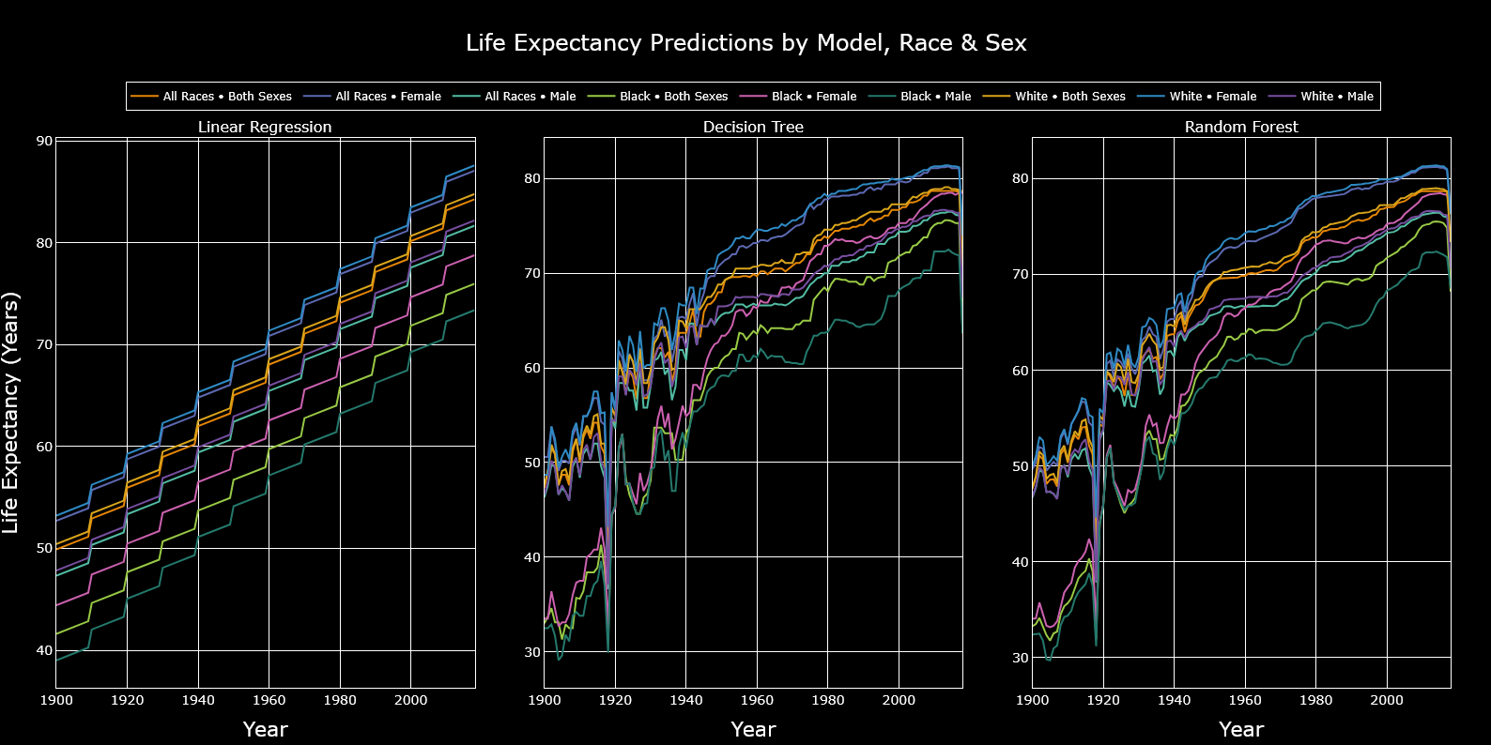
Results
Results
Life Expectancy Analysis

Slide 11
Sex-Based Trends
Demographics
Life Expectancy Analysis
Reduced Conflict Mortality: Fewer large-scale wars (post-20th-century conflicts) compared to 1900s-era combat deaths.
Dietary Shifts: Transition from calorie-dense, meat/carb-heavy diets (common in manual labor) to balanced nutrition, reducing obesity and heart disease risks.
Workplace Safety: Automation in male-dominated industries (construction, manufacturing) minimizes accidents and chronic occupational hazards.
Health Awareness: Decline in smoking rates, increased preventive care, and focus on mental health.

Slide 12
Race-Based Trends
Demographics
Life Expectancy Analysis
Healthcare Access: Expansion of Medicaid and community health programs in underserved areas.
Socioeconomic Initiatives: Poverty reduction policies (e.g., earned income tax credits) improving living standards.
Chronic Disease Management: Targeted interventions for hypertension and diabetes in Black communities.
Post-Pandemic Rebound: Post-2020 investments in health infrastructure reduced disparities.

Slide 13
Recommendations & Ethical Considerations
Recommendations
Life Expectancy Analysis
Continue or increase investment in equity amongst demographics
Drastic changes to ongoing investments will have drastic impacts on these forecasts
Decrease food deserts and increase nutrition availability
Reduce carbon footprint
Create walkable cities
Worker safety regulations and data-driven automation in dangerous, male dominated fields
Most importantly - education. More time and resources put into educating the public on the facts, and then let them decide for themselves.

Slide 14
Conclusion
Conclusion
Life Expectancy Analysis
Predictive modeling revealed narrowing gaps in life expectancy, projecting a rise to 90 years by 2037, emphasizing the role of healthcare advancements and socioeconomic equity in shaping future outcomes
Ensemble methods like Random Forest Regression (MAE: 0.54) clearly show complex demographic interactions
Particularly pandemic impacts and systemic inequities.
These findings urge policymakers to prioritize targeted investments in healthcare access, workplace safety, and nutrition equity to sustain projected gains.
As global populations age, proactive strategies, rooted in data-driven insights, will be critical to mitigating economic strain and ensuring long-term societal stability.

Slide 15
Thank You
May 11th, 2025

Slide 16








Tools and Libraries
Appendix II
Life Expectancy Analysis
Python
Pandas
Matplotlib
Seaborn
Scikit-learn
Numpy
Urllib
Plotly
Jupyter Notebook

Slide 17
Data Sources
Key Variables
Appendix
Life Expectancy Analysis
Death Rates and Life Expectancy (1900-2018)
Access Date: April 2025
https://www.cdc.gov/nchs/data-visualization/mortality-trends/index.htm
Historical Apportionment Data (1910-2020)
Access Date: April 2025
https://www.census.gov/data/tables/time-series/dec/apportionment-data-text.html
Year: Placed in decade buckets
Race: Two primary races (Black and White), polar due to data limitations in the early days
Sex: Male and female sexes for better categorization and finite insight
Average Life Expectancy (Years): Average number of years expected to live
Age-adjusted Death Rate: Statistical measure used to compare mortality rates between populations with different age distributions
Resident population: Total population in the United States

Slide 18
References
References
Life Expectancy Analysis
Bureau, U. C. (2022, August 6). Historical Apportionment Data (1910-2020). Census.gov. https://www.census.gov/data/tables/time-series/dec/apportionment-data-text.html
Centers for Disease Control and Prevention. (n.d.). Mortality trends in the United States, 1900–2018. https://www.cdc.gov/nchs/data-visualization/mortality-trends/index.htm
Countries with Declining Population 2025. (2025-04-30). World Population Review. https://worldpopulationreview.com/country-rankings/countries-with-declining-population

